Slide 1
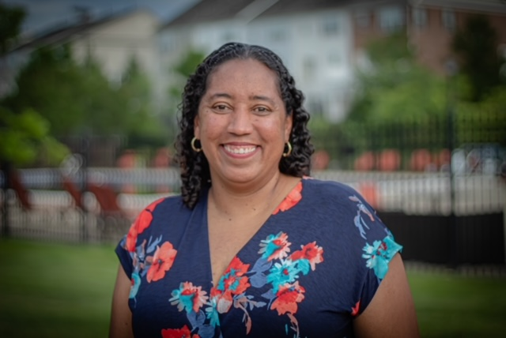

Oak Creek Club Homeowner Highlight
The Homeowner Highlight recognizes a homeowner monthly who has made a volunteer contribution to the Oak Creek Community.
The December 2020 Homeowner Highlight is:
Mrs. Stacey Ann Baugh-Angel Tree Coordinator @ Oak Creek

Slide 2
I have lived here since July 2008.
Christmas is my favorite time of the year. I am also someone who loves giving and receiving gifts. The Angel Tree Program allows me to help ensure local kids get to have a special Christmas filled with the things they wished for. The first time I got involved there were hundreds of kids who did not have sponsors at the end of the program. That led me to start looking for sponsors among my friends, family and eventually the broader Oak Creek community. This year I am a core member of the social distance birthday crew and one of the people who coordinated the Oak Creek graduation celebration. I don't sit on any committees but I am close with several past and present members of the social committee. I am always willing to volunteer to help set up and support their events.
I am island girl originally from Jamaica, but my favorite food would probably be Italian food - alfredo pasta and risotto.
My favorite season is Fall.
My favorite thing about Oak Creek is how warm a community it is. It feels like a family in many respects. I enjoy socializing with my neighbors many of whom have now become some of my dearest friends. When we were allowed to hang out :-) We could often be found relaxing at the Grove catching up and supporting each other.

