Slide 1
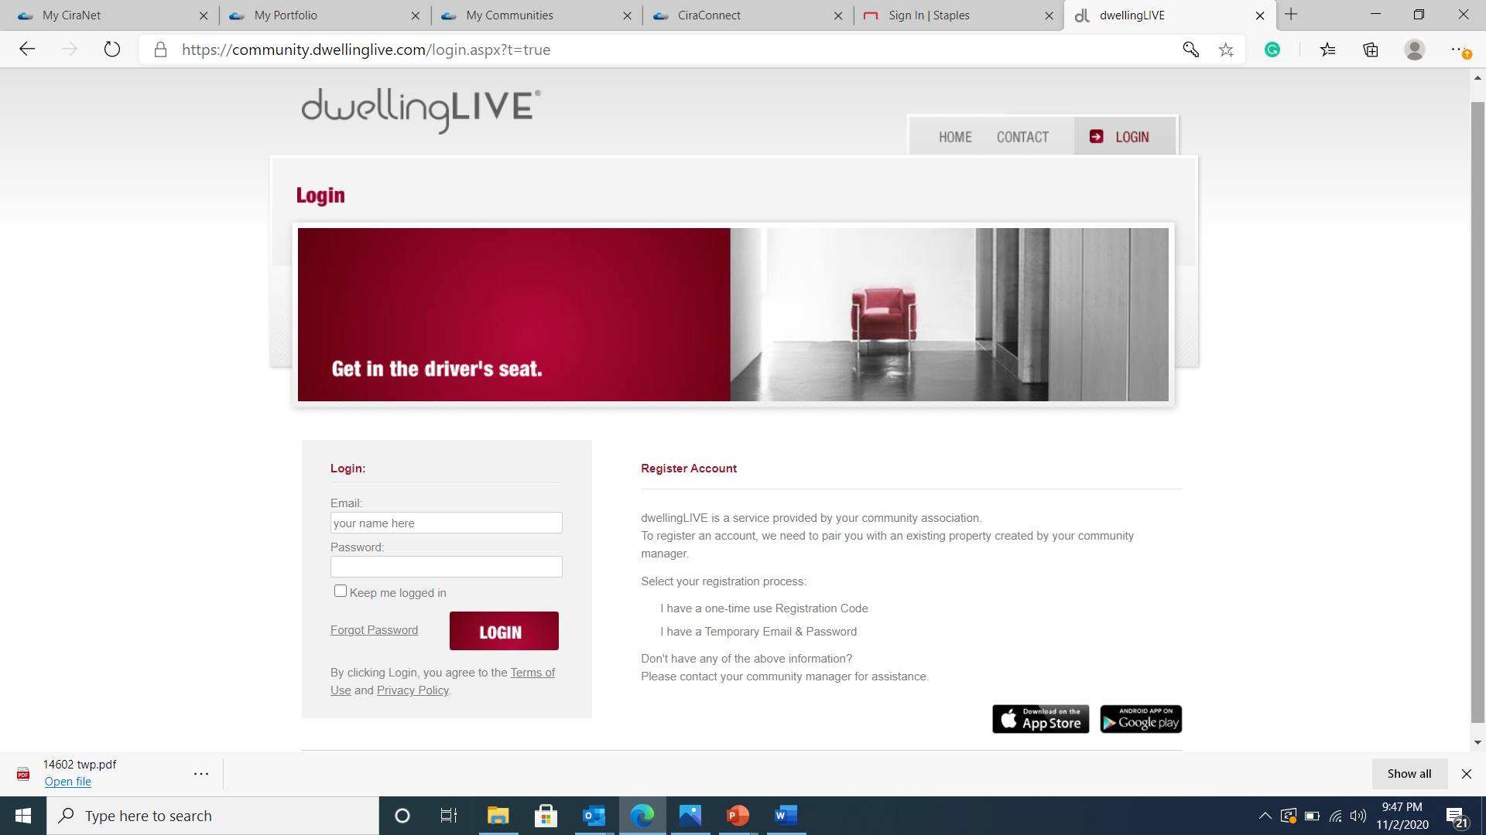
Dwelling Live
GUEST MANAGEMENT SYSTEM

Slide 2
Dwelling live is the guest management system for visitor access through the gates.
Each oak creek member receives their log in credential from the homeowners association and should update their password when they log in.

Slide 3
Access control can grant access to guest when you’re not home by viewing your guest list
You can also leave access control notes in the system
When adding to your guest list please enter first and last names. Access control will verify your guest by their ID

Slide 4
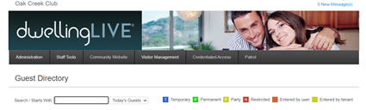
Permanent Guest VS Temporary Guest
Guest can be temporary or permanent .
You can enter expiration dates for temporary guest
Having a party? Add all party guest
You can also restrict guest from the community

Slide 5
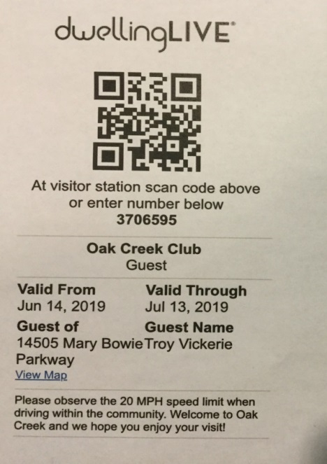
Print parking pass for you or your guest
Parking passes can be requested from the Homeowners association or you can produce them directly from the guest management system

